Slide 1

Used car prize prediction Model
Submitted by : Bhushan Kumar Sharma
Designation: Intern Data Scientist
Company : Flip Robo Technologies

Slide 2
Problem Statement
With the covid 19 impact in the market, we have seen lot of changes in the car market. Now some cars are in demand hence making them costly and some are not in demand hence cheaper. One of our clients works with small traders, who sell used cars. With the change in market due to covid 19 impact, our client is facing problems with their previous car price valuation machine learning models. So, they are looking for new machine learning models from new data. We have to make car price valuation model. This project contains two phase

Slide 3
Features overview
# Title : Car Title
# History : Car History (Accidental or not)
# Kilometer : Car Driven km
# Location : Car registered location
# Year : Car purchased year
# Onwer : Car owner (1st or 2nd etc.)
# fuel : Car fuel type
# transmission : Car transmission (Automatic or Manual)
# prize : Car (car prize)

Slide 4
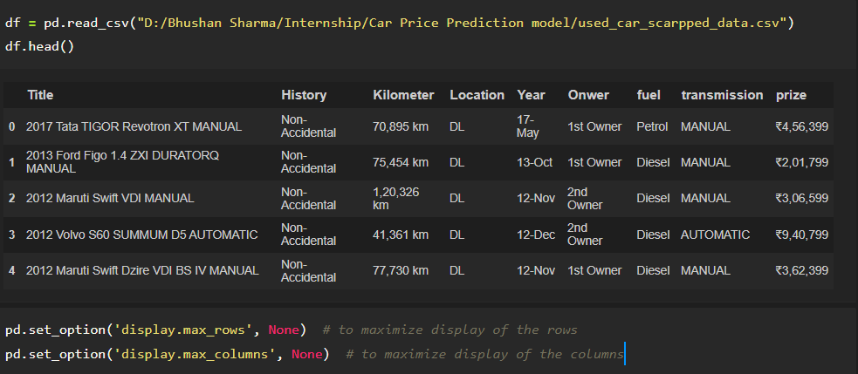
Loading dataset
As we can see, this is raw data, I have applied lots of pre processing techniques for making best data for model building

Slide 5
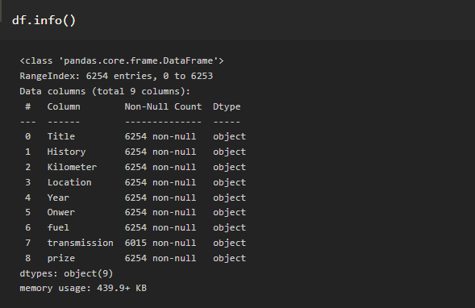
Information of dataset
When I had scrapped data from website that time these columns type was of object type
Here, transmission column is having null value, but that is filled by “-”, therefore, “-” is replaced with null value, then applied null value operation accordingly

Slide 6
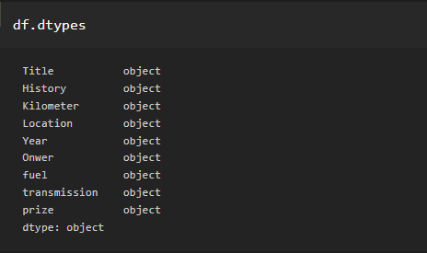
Datatype of feature
Initially, Every column is of object type.

Slide 7
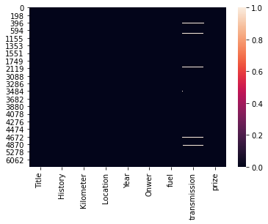
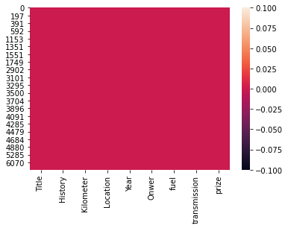
Checking null values
Before
After
As dropping operation of null value was giving very less data loss (less than 5%), therefore, I have drop null value.

Slide 8
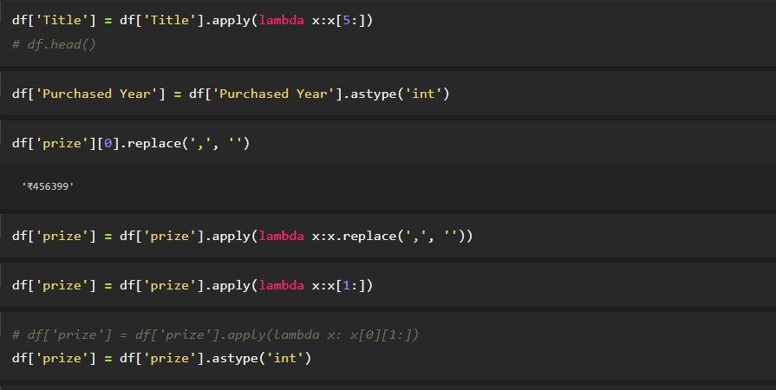
Data Preprocessing

Slide 9
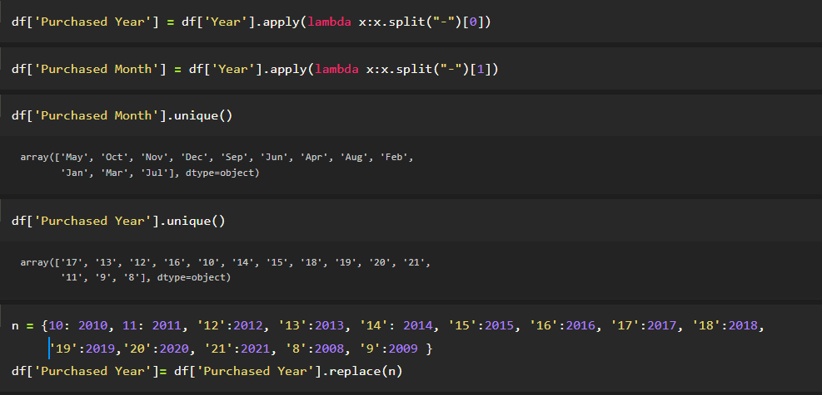
Data Preprocessing

Slide 10
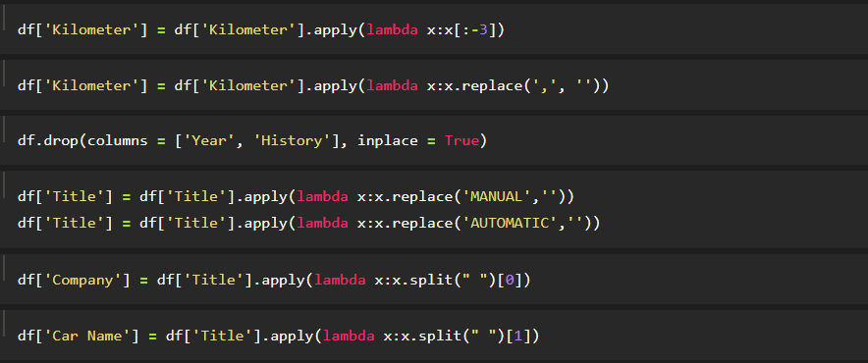
Data Preprocessing

Slide 11
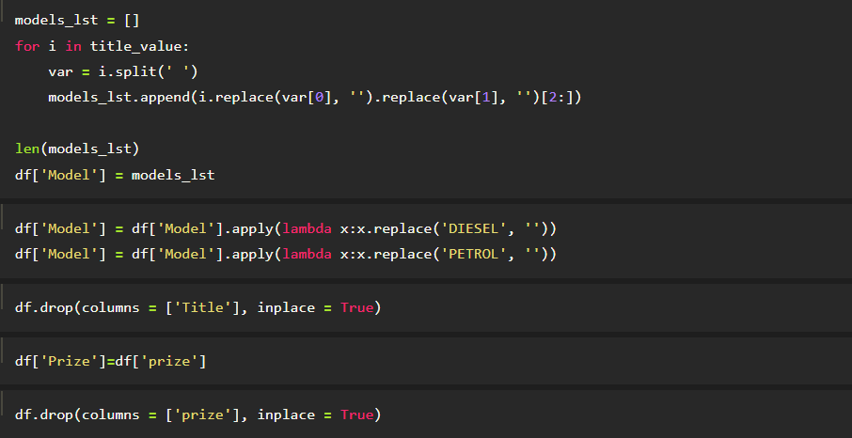
Data Preprocessing

Slide 12
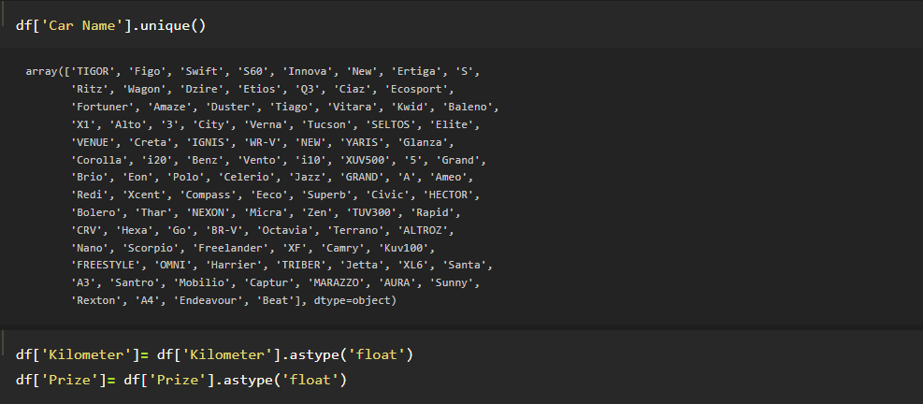
Data Preprocessing
These few slides are of data preprocessing steps, which I have applied on dataset.

Slide 13
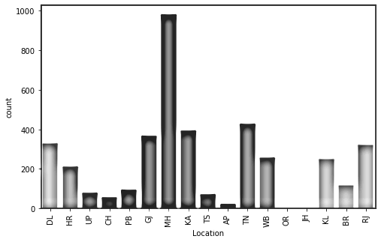
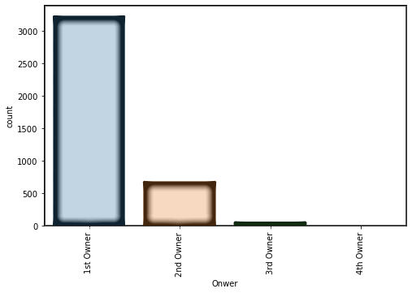
Bar Graph for variables
Majority vehicle is from ‘MH’ region, and least is from ‘JH’
Maximum used car is of 1st owner and very few car having 4th owner.

Slide 14
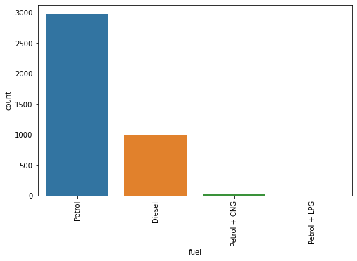
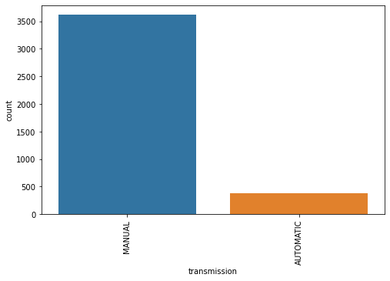
Majority vehicle is of Petrol variant and very less vehicle is having Petrol + LPG
Maximum car is manual transmission type.

Slide 15
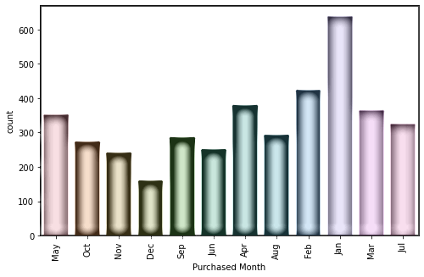
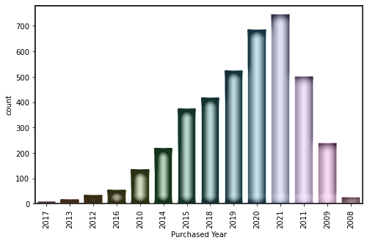
As maximum vehicle registration month is jan, it may be because of new year month. Accordingly one can apply some special offer in this month for increase sell of vehicle

Slide 16
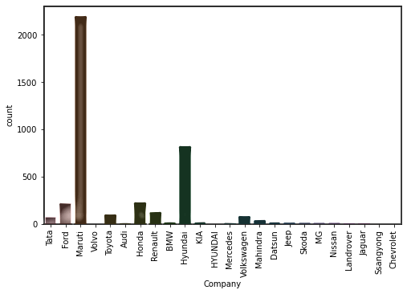
Top 3 company cars in market, Maruti, Hyundai, Ford

Slide 17
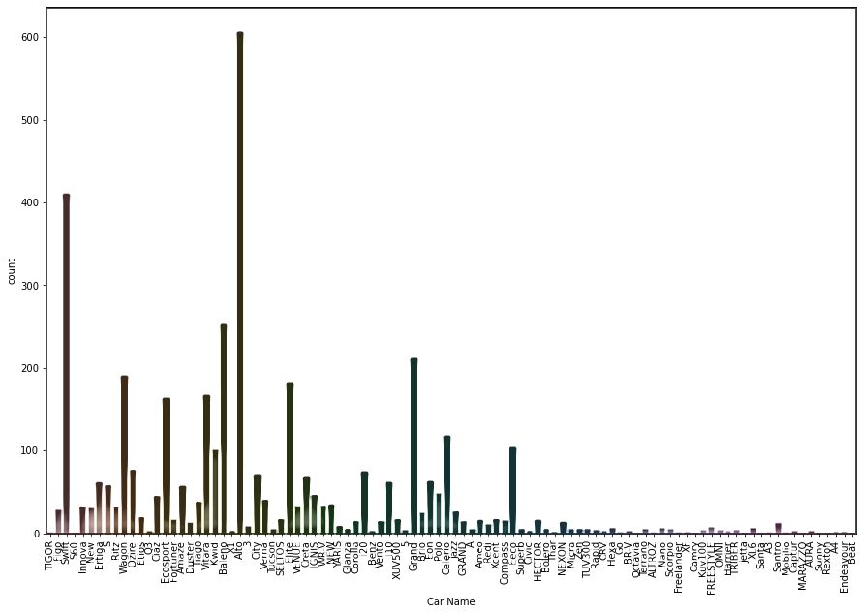

Slide 18
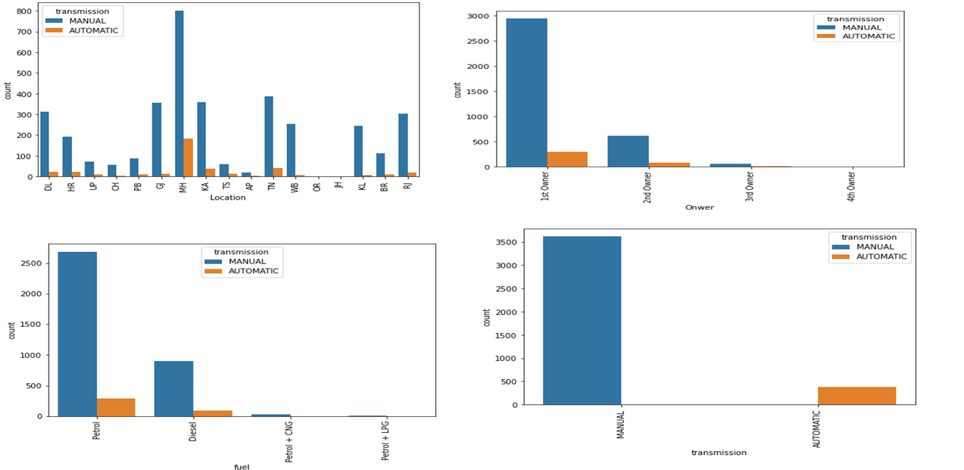

Slide 19
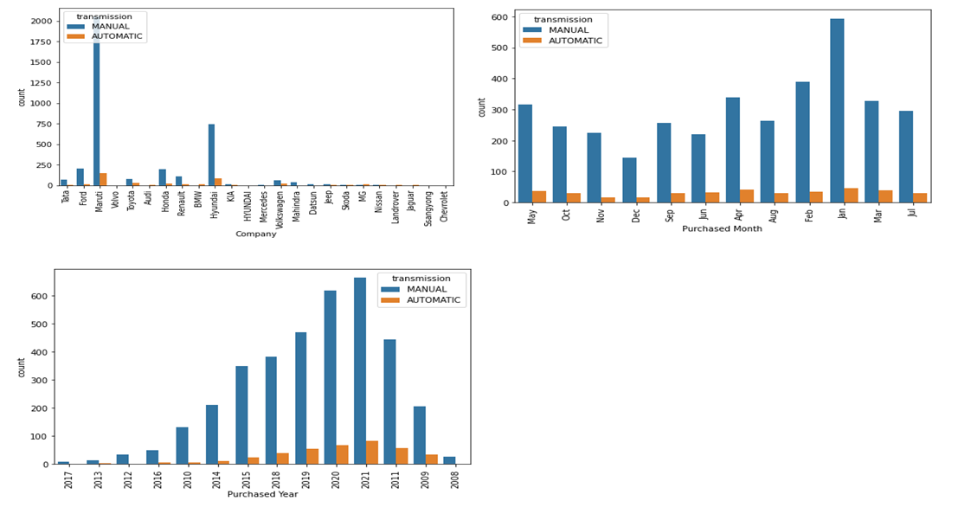

Slide 20
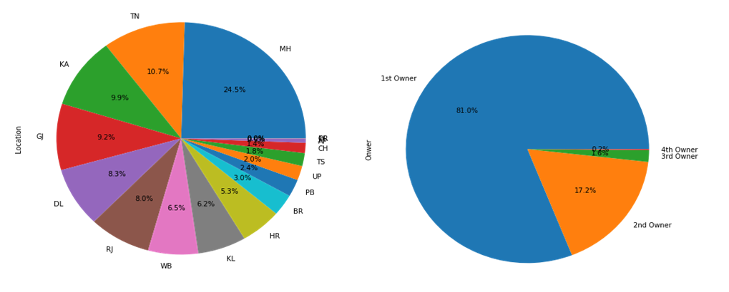
Pie Chart for variables

Slide 21
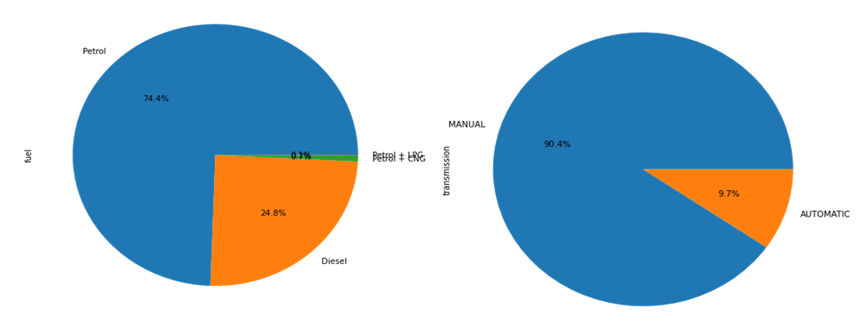
Pie Chart for variables

Slide 22
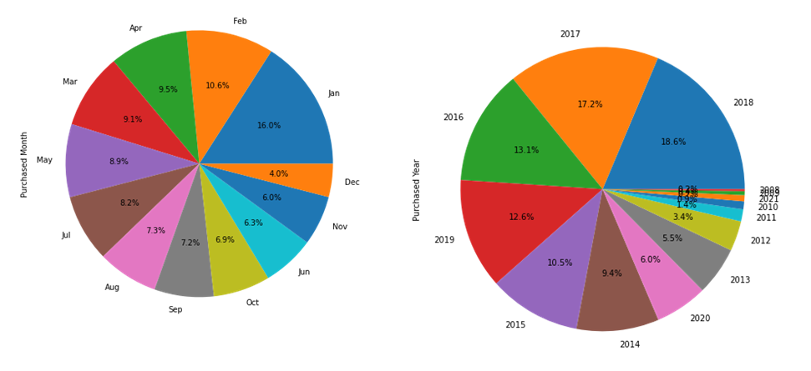
Pie Chart for variables

Slide 23
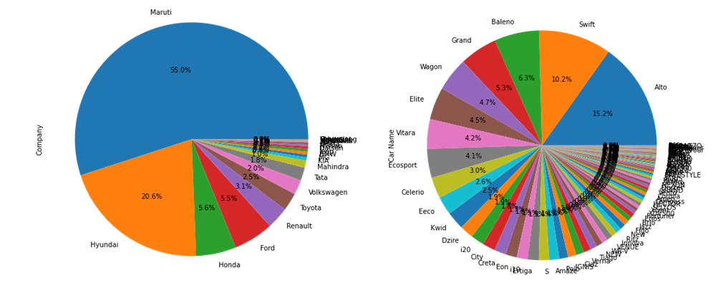
Pie Chart for variables

Slide 24
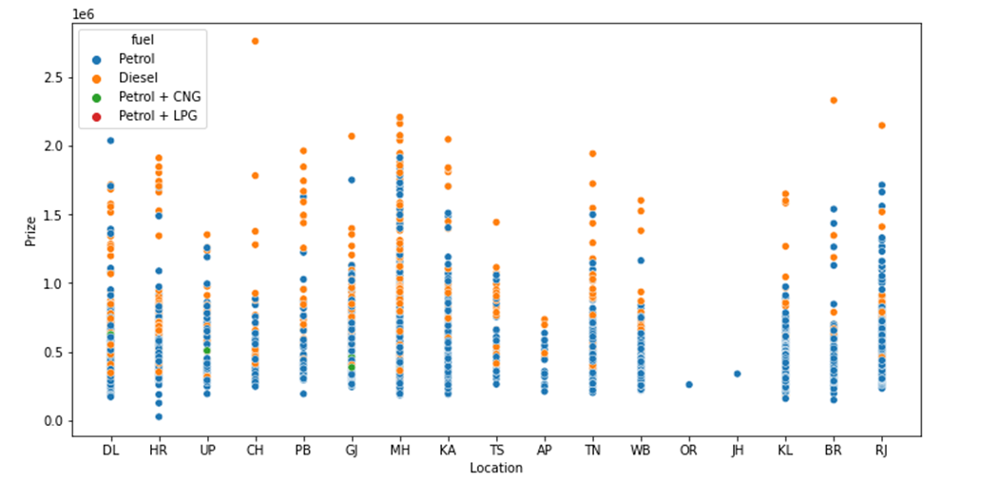
Bivariate Analysis
We can see, highest prize is of diesel cars and cars which are having petrol+CNG & LPG are having less low prize

Slide 25
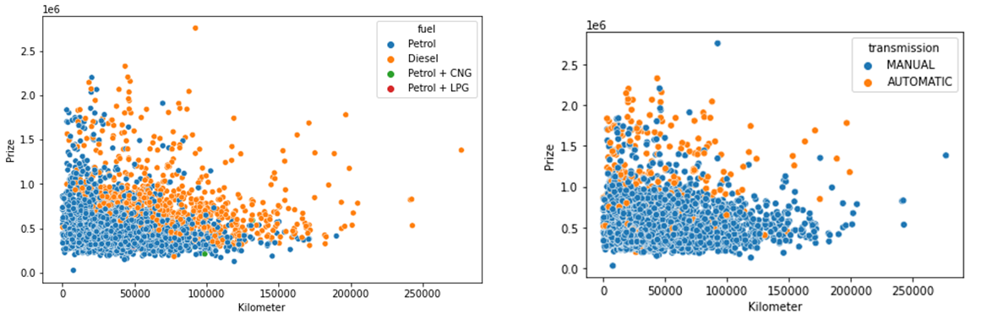
Bivariate Analysis
Automatic and Diesel Variant cars are having higher rate as compare to other variants car.

Slide 26
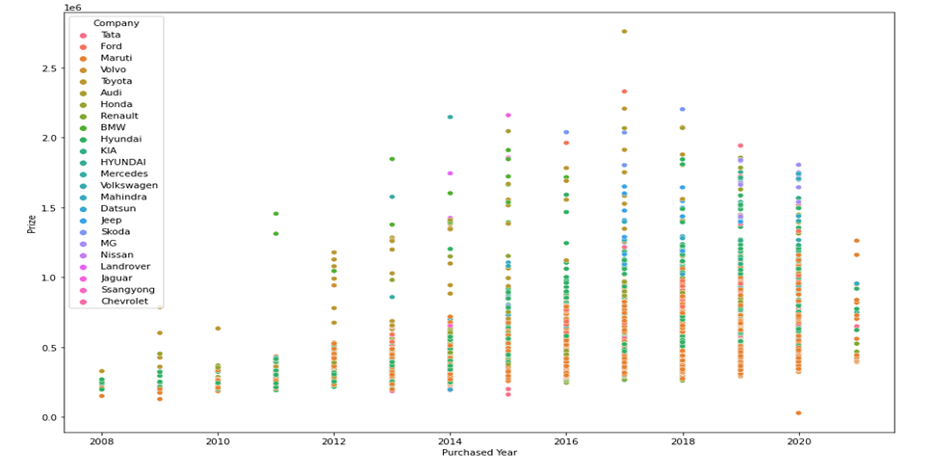
Bivariate Analysis
Volvo car is having highest value, and maximum car is of Hundai, Maruti and etc.

Slide 27
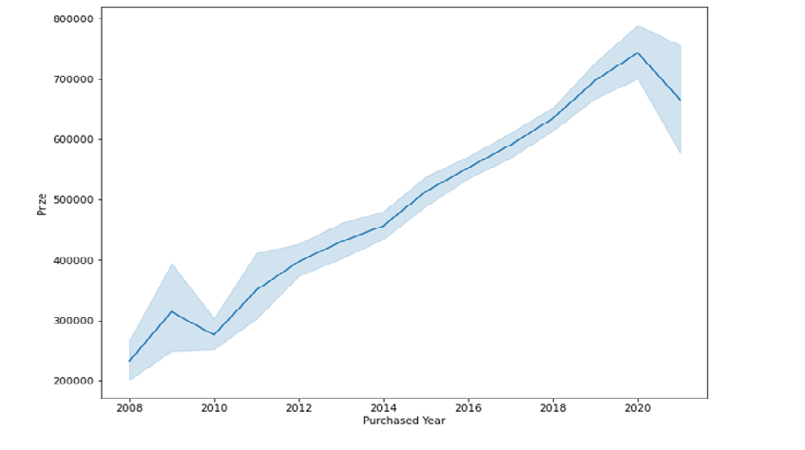
Bivariate Analysis
Prizes are going up with increase in model year, which is very obvious as newer the model prize will increase accordingly.

Slide 28
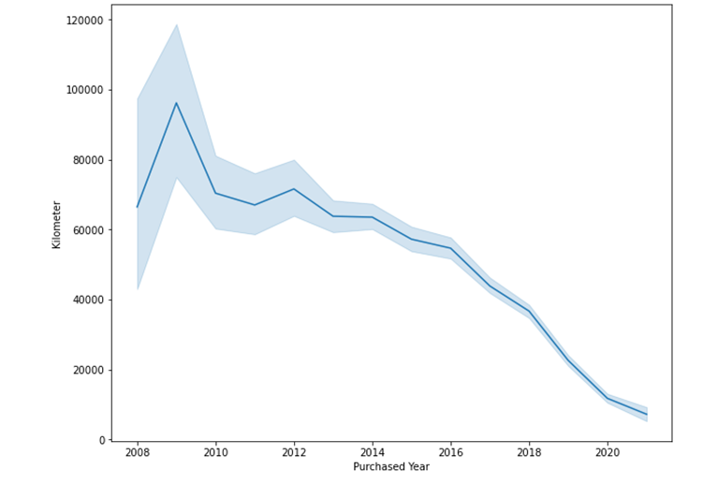
Bivariate Analysis
As much newer model car one will choose, that much less driven car would be available.

Slide 29
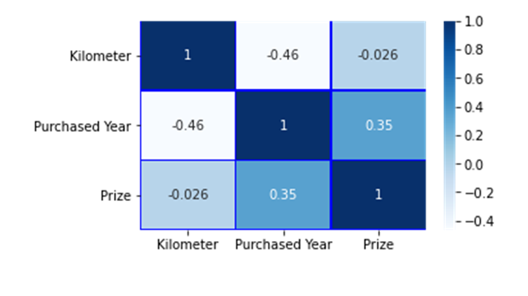
Correlation of columns
Numeric columns are not much correlated with each other, as they are showing less value of correlation
As these column are not showing much correlation, it would be helpful to build a good model of machine learning

Slide 30
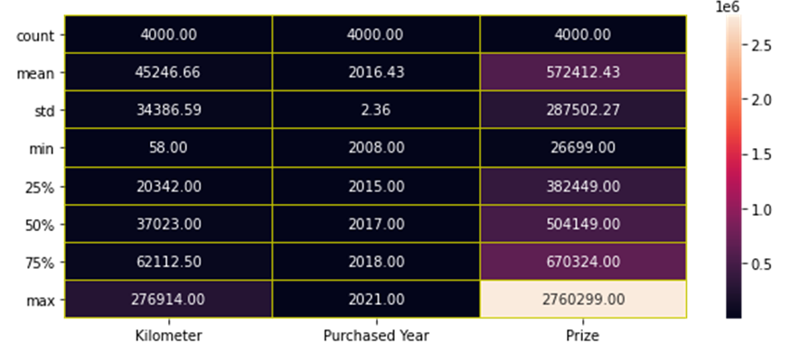
Describe Dataset
Kilometer and Prize columns min and max value are having high difference, we can say these column are highly spread
Mean and 50 percentile value is having some value difference, mean these columns are having skewness
Count for each column is same mean no null value present
25% and 75% is having difference , which also indicating , column spreadness

Slide 31
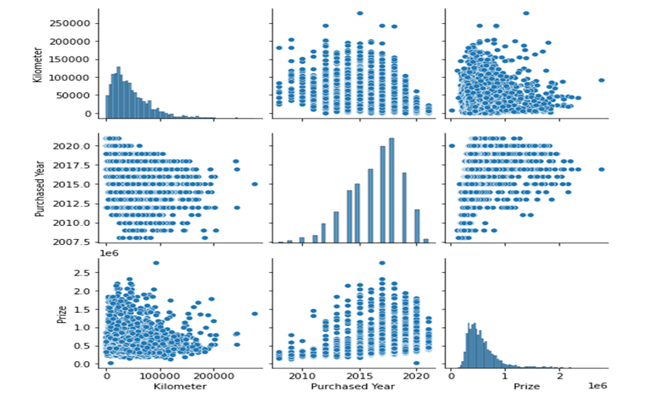
Pairplot of Dataset

Slide 32
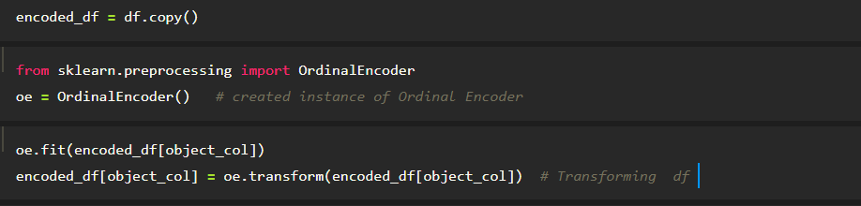
Applied Encoding
Ordinal Encoding is used for feature columns, therefore, here I have applied ordinal encoding to the feature column of the dataset

Slide 33
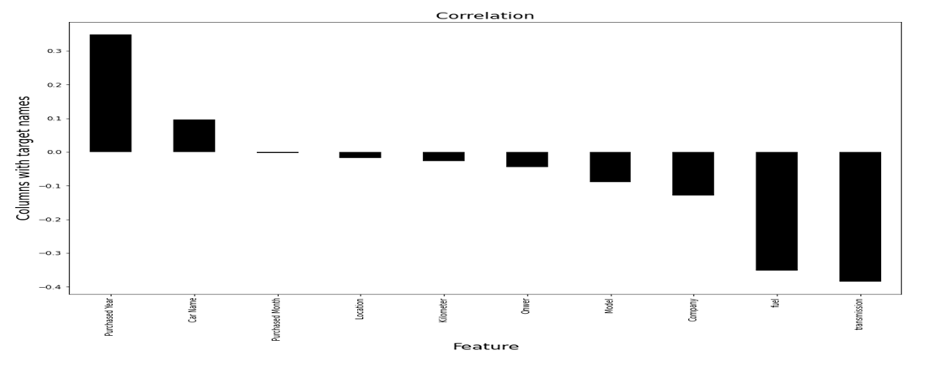
Impact of Target variable
Purchase year positively impacting prizes whereas, transmission is negatively impacting (Manual varient is of less prize as compare to Automatic one)

Slide 34
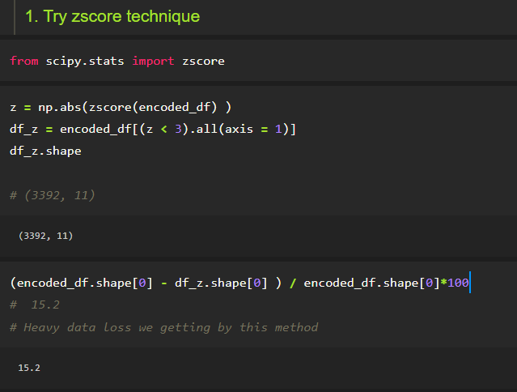
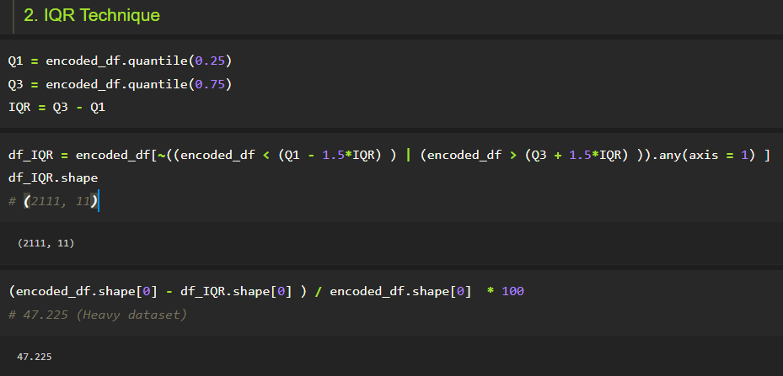
Outliers not remove due to heavy loss
Both outliers removing techniques is giving high loss of data, therefore, I have word on dataset without removing outliers

Slide 35
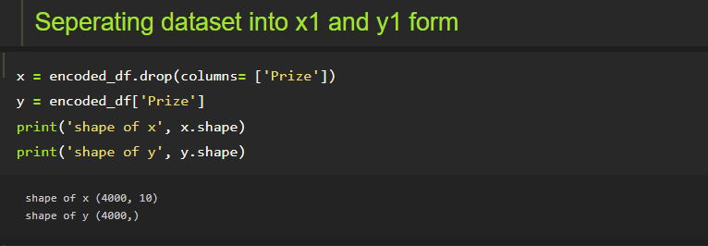
Separating data into x and y form
After separating, the dataset into x and y form, we are having 10 feature columns and 1 target column (prize)

Slide 36
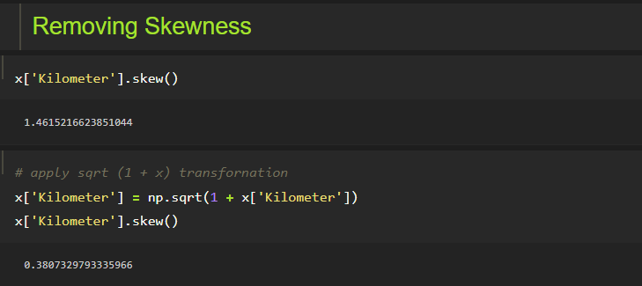
Removing Skewness
Applied square root transformation technique for removing skewness of ‘Kilometer’ column

Slide 37
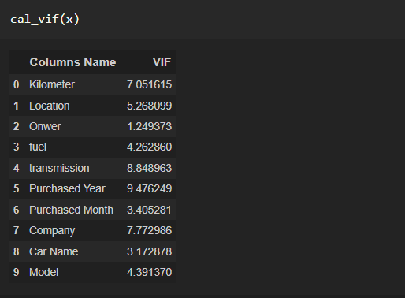
Multicollinearity
We have to check for only Kilometer column, and for this column VIF value is in acceptable range.
Every column is showing VIF value under acceptable range,
Hence, dataset is is not having Multicolinearity

Slide 38
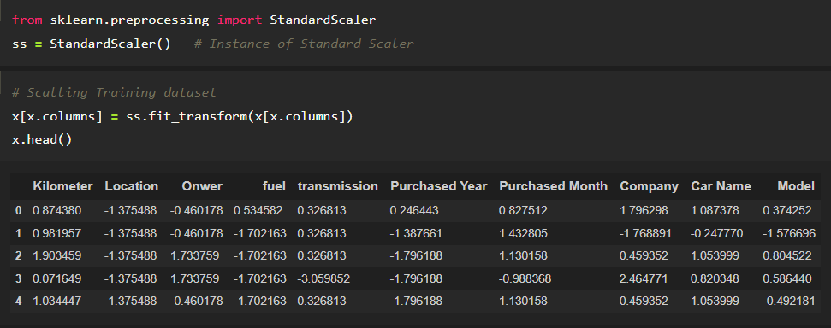
Applied Standard Scaling
Just one step before of machine learning, this scaling is applied to make sure, equal weightage of each column should be occur during machine learning.

Slide 39
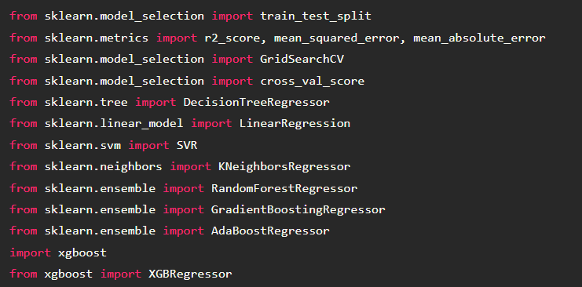
Machine learning
These libraries used for building model of machine learning

Slide 40
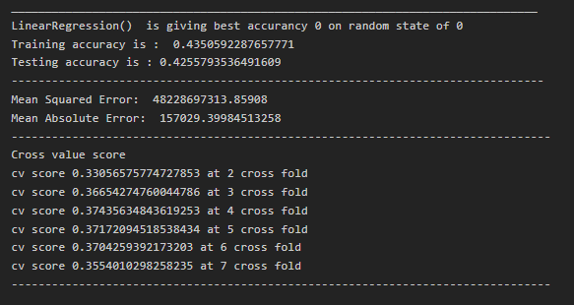
Linear Regression model
This model is having very less accuracy of model and having very difference between cv and accuracy of model

Slide 41
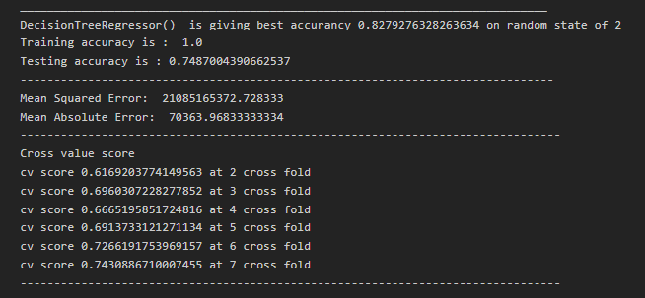
Decision Tree Regressor Model
By applying this model, getting overfitted model, as its traing accuracy is higher than testing accuracy
Training Accuracy > Testing Accuracy

Slide 42
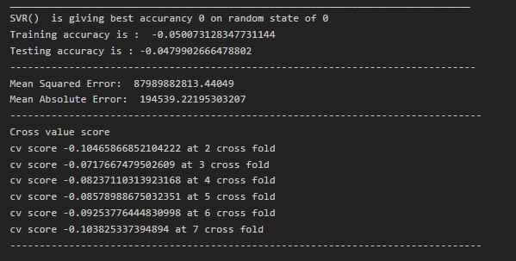
Support vector regressor model
This model is working for this dataset, we can not conclude anything for this model

Slide 43
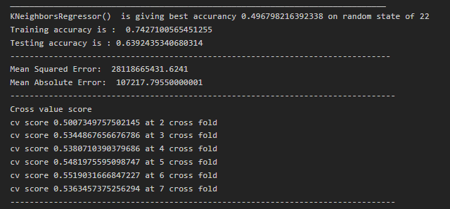
kNeighbors Regressor Model
This model is also giving overfitted model, and also having very difference in cv score value and accuracy value

Slide 44
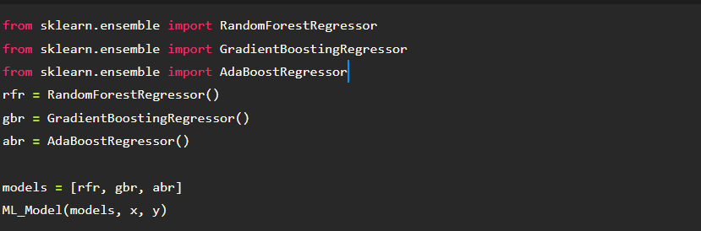
Applied Bagging and Boosting techniques
Bagging and Boosting techniques are applied on the dataset because normal alogorithm was not giving enough result or good result

Slide 45
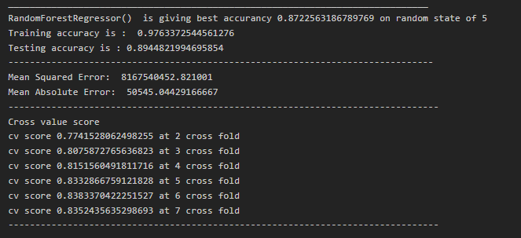
Random Forest regressor model
Having difference in accuracy of training and testing dataset, not much but having,
Also having high difference between cv and Accuracy of model

Slide 46
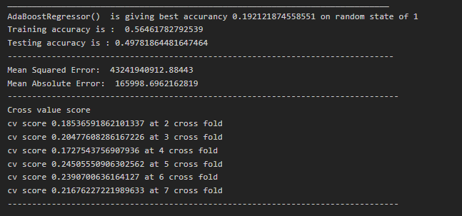
Adaboostregressor model
ML_Model function is created for smooth operation of machine learning
Logistic Model performance

Slide 47
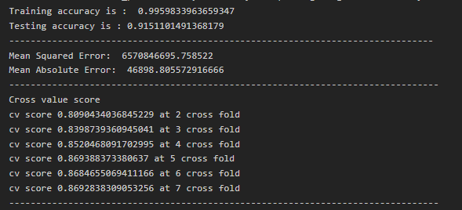
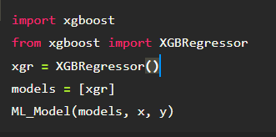
Xgboost regressor model
This is model is giving good resule but giving over fitted model

Slide 48

Gradient Boosting Regressor
This model is giving good result as it not having much difference in accuracy of training and testing dataset
And also not having high cv value and accuracy difference

Slide 49

Ensemble Technique of GradientboostingClassifier
‘parameter’ these are the parameters which have to be applied on given model and then have to choose best one.
GridSearchCV will help in that

Slide 50

Ensemble Technique of GradientboostingClassifier
Found best parameter and applied passed those parameter with GradientBoosting Algorithm to get best results.

Slide 51

These passed parameters have increase accuracy and cv value of Gradient boost
Hence, this model selected as final model for deployment.

Slide 52


Final Model Proformance
Neigher overfitted nor underfitted model, we are getting by this algorithm
CV is also very near to testing accuracy
Now, need to deploy this model as final machine learning model

Slide 53


Performance Graph
Graph for model performance
As model is giving 90 % accuracy , therefore, we points are divert from the actual value

Slide 54

Deploy and load model
Deployed model by using pickle library of python
After deploying the model same model imported and checked accuracy of that same model and found model is giving 0.90 accuracy as previous.
Means deploy process is successfully executed

Slide 55

Conclusion
One dataframe is created by the name “conclusion”, in this dataframe both (predicted and acutal ) values will be imputed.
By this dataframe one can see the difference between actual and predicted value

Slide 56

Conclusion
Comparing some value of actual dataset with predicted value by model

Slide 57
Thanks you

